Slide 1
Introduction Data Science Process and Data Acquisition

Slide 2
Data Science
Definition: It is the study of how we transform raw observation(data) into meaningful information.
Data Science is blended of various tools, Algorithms and Machine learning with goal to discover hidden patterns from raw data

Slide 3
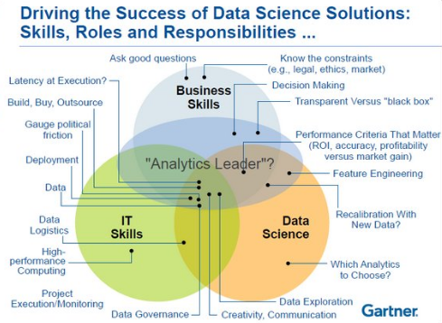

Slide 4
Data Science
Data Science
Transform raw data into meaningful Information
Discover hidden patterns from raw data
Blended of various tools, Algorithms and Machine Learning
Business Skills and Data Governance
Data Exploration, Analytics
Data Engineering
Adoption of AI and Machine Learning
(For Intelligent and Accurate Decision Making)

Slide 5
Data Science
Statistics & Mathematics Machine Learning
Qualitative Quantitative Classification Clustering
It is used for collecting and analyzing numerical data in large quantities to get useful insights
M.L: Explores the building and study of algorithms which learn to make prediction future data

Slide 6
In data science there are mainly three algorithms are used
Data Preparation, Data munging and Process Algorithm
Optimization algorithms for parameter estimation which includes
Stochastic Gradient Descent
Least Square
Newton’s Method

Slide 7
3. Machine Learning Algorithm
For prediction, categorize, classify etc. From given data sets
Supervised Learning
Regression
Linear
Polynomial
Decision Tree
Random Forest
Classification
SVM
KNN
NN

Slide 8
Unsupervised Learning
Clustering & Dimension Reduction
Reduction
SVD
PCA
K-means

Slide 9
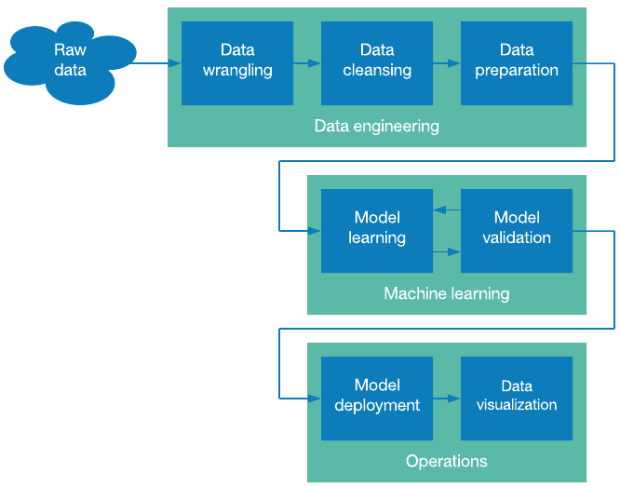
Data Science Process / Model

Slide 10
Data wrangling Process / Model
Data wrangling, simply defined, is the process of manipulating raw data to make it useful for data analytics or to train a machine learning model.
There are typically six iterative steps that make up the data wrangling process.
Discovering: How you wrangle customer data, for example, may be informed by where they are located, what they bought, or what promotions they received.
Structuring: This means organizing the data, which is necessary because raw data comes in many different shapes and sizes. A single column may turn into several rows for easier analysis. One column may become two. Movement of data is made for easier computation and analysis

Slide 11
Data Wrangling Process / Model
There are typically six iterative steps that make up the data wrangling process.
Cleaning: What happens when errors and outliers skew your data? You clean the data. What happens when state data is entered as CA or California or Calif.? You clean the data. Null values are changed and standard formatting implemented, ultimately increasing data quality.
Enriching: Here you take stock in your data and strategize about how other additional data might augment it. Questions asked during this data wrangling step might be: what new types of data can I derive from what I already have or what other information would better inform my decision making about this current data

Slide 12
Data wrangling Process / Model
There are typically six iterative steps that make up the data wrangling process.
Validating: Validation rules are repetitive programming sequences that verify data consistency, quality, and security. Examples of validation include ensuring uniform distribution of attributes that should be distributed normally (e.g. birth dates) or confirming accuracy of fields through a check across data.
Publishing: Data analyst is responsible for mining vast amount of data patterns, trends relationship in data.
Analysts prepare the wrangled data for use downstream – whether by a particular user or software – and document any particular steps taken or logic used to wrangle said data

Slide 13
What is Data Munging?
The process of manual data cleansing prior to analysis is known as data munging. This process can be a laborious task without the right tools.
The common interface used for data munging is often Excel, which lacks the sophistication for collaboration and automation to make the process efficient. 80% of the time spent on data analytics is allocated to data munging, where IT manually cleans the data to pass over to business users who perform analytics.

Slide 14
Data preparation
The final step in data engineering is data preparation (or preprocessing).
This step assumes that you have a cleansed data set that might not be ready for processing by a machine learning algorithm.
Here are a couple of examples where this preparation could apply.
In some cases, normalization of data can be useful. Using normalization, you transform an input feature to distribute the data evenly into an acceptable range for the machine learning algorithm.
This task can be as simple as linear scaling (from an arbitrary range given a domain minimum and maximum from -1.0 to 1.0). You can also apply more complicated statistical approaches.

Slide 15
Data preparation
normalization can help you avoid getting stuck in a local optima during the training process (in the context of neural networks).
Another useful technique in data preparation is the conversion of categorical data into numerical values. Consider a data set that includes a set of symbols that represent a feature (such as {T0..T5}).
As a string, this isn't useful as an input to a neural network, but you can transform it by using a one-of-K scheme (also known as one-hot encoding).

Slide 16
Machine / Model Learning
Model Learning
Collect Data
Update Data
Store Data
Business analyst
Discovering Data
Analyzing Data
Specifying Changes how S/W system create and maintain transformation

Slide 17
Machine / Model Learning
Data Modeller
create an entity relationship diagram to visualize relationships between key business concepts
create a conceptual-level data dictionary to communicate data requirement that are important to business stakeholders
create a data map to resolve potential data issues for a data migrate on or integration project.
Data modelers often use multiple models to view the same data and ensure that all processes, entities, relationships and data flows have been identified.

Slide 18
Machine / Model Learning
Data Modeller
initiate new projects by gathering requirements from business stakeholders.
Data modeling stages roughly break down into creation of logical data models that show specific attributes, entities and relationships among entities and the physical data model

Slide 19
Machine / Model Learning
In this phase, you create and validate a machine learning model.
Sometimes, the machine learning model is the product, which is deployed in the context of an application to provide some capability (such as classification or prediction).

Slide 20
Machine / Model validation
After a model is trained, how will it behave in production? One way to understand its behavior is through model validation.
A common approach to model validation is to reserve a small amount of the available training data to be tested against the final model (called test data).
You use the training data to train the machine learning model, and the test data is used when the model is complete to validate how well it generalizes to unseen data

Slide 21
Operations
Operations refers to the end goal of the data science pipeline. This goal can be as simple as creating a visualization for your data product to tell a story to some audience or answer some question created before the data set was used to train a model.

Slide 22
Data Science life cycle
Discovery
Data Preparation
Model Planning
Model Building
Operationalize
communicate Results

Slide 23
Phase 1—Discovery:
Before you begin the project, it is important to understand the various specifications, requirements, priorities and required budget.
Here, you assess if you have the required resources present in terms of people, technology, time and data to support the project.
In this phase, you also need to frame the business problem and formulate initial hypotheses (IH) to test

Slide 24
Phase 2—Data preparation:
Phase 2—Data preparation: In this phase, you require analytical sandbox in which you can perform analytics for the entire duration of the project.
You need to explore, preprocess and condition data prior to modeling. Further, you will perform ETLT
(extract, transform, load and transform) to get data into the sandbox.
You can use R for data cleaning, transformation, and visualization. This will help you to spot the outliers and establish a relationship between the variables. Once you have cleaned and prepared the data, it’s time to do exploratory analytics on it.

Slide 25
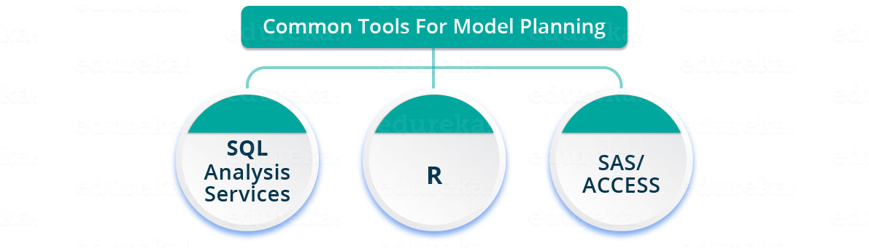
Phase 3—Model planning continue…
Phase 3—Model planning: Here, you will determine the methods and techniques to draw the relationships between variables. These relationships will set the base for the algorithms which you will implement in the next phase. You will apply Exploratory Data Analytics (EDA) using various statistical formulas and visualization tools.

Slide 26
Exploratory Data Analytics
Exploratory Data Analysis refers to the critical process of performing initial investigations on data so as to discover patterns, to spot anomalies, to test hypothesis and to check assumptions with the help of summary statistics and graphical representations.

Slide 27
Phase 3—Model planning
R has a complete set of modeling capabilities and provides a good environment for building interpretive models.
SQL Analysis services can perform in-database analytics using common data mining functions and basic predictive models.
SAS/ACCESS can be used to access data from Hadoop and is used for creating repeatable and reusable model flow diagrams.

Slide 28
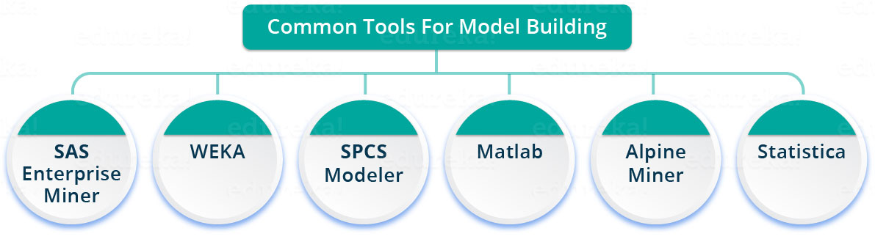
Phase 4—Model building
Phase 4—Model building: In this phase, you will develop datasets for training and testing purposes.
You will consider whether your existing tools will suffice for running the models or it will need a more robust environment (like fast and parallel processing).
You will analyze various learning techniques like classification, association and clustering to build the model.

Slide 29
Phase 5—Operationalize
Phase 5—Operationalize: In this phase, you deliver final reports, briefings, code and technical documents. In addition, sometimes a pilot project is also implemented in a real-time production environment.
This will provide you a clear picture of the performance and other related constraints on a small scale before full deployment.

Slide 30
Phase 6—Communicate results
Phase 6—Communicate results: Now it is important to evaluate if you have been able to achieve your goal that you had planned in the first phase.
So, in the last phase, you identify all the key findings, communicate to the stakeholders and determine if the results of the project are a success or a failure based on the criteria developed in Phase 1.

Slide 31
Is this A or B?
With this question, we are referring to problems which have a categorical answer, as in problems which have a fixed solution, the answer could either be a yes or a no, 1 or 0, interested, maybe or not interested.
For Example:
Q. What will you have, Tea or Coffee?
Here, you cannot say you would want a coke! Since the question only offers tea or coffee, and hence you may answer one of these only.
When we have only two type of answers i.e yes or no, 1 or 0, it is called 2 – Class Classification. With more than two options, it is called Multi Class Classification.

Slide 32
Case Study: Diabetes Prevention
What if we could predict the occurrence of diabetes and take appropriate measures beforehand to prevent it?
In this case study let us predict the occurrence of diabetes making use of the entire lifecycle of Data Science
Let’s go through the various steps.

Slide 33
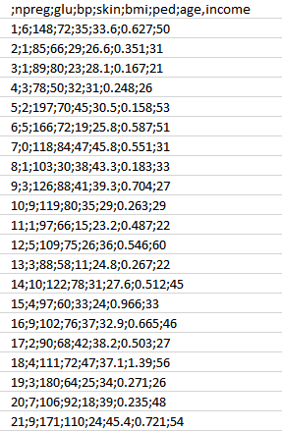
Step 1: First, we will collect the data based on the medical history of the patient as discussed in Phase 1. You can refer to the sample data below.
Attributes:
npreg – Number of times pregnant
glucose – Plasma glucose concentration
bp – Blood pressure
skin – Triceps skinfold thickness
bmi – Body mass index
ped – Diabetes pedigree function
age – Age
income – Income

Slide 34
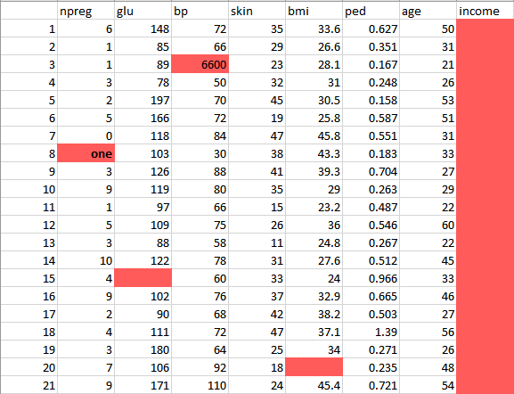
Step 2: continued….
Now, once we have the data, we need to clean and prepare the data for data analysis.
This data has a lot of inconsistencies like missing values, blank columns, abrupt values and incorrect data format which need to be cleaned.
Here, we have organized the data into a single table under different attributes – making it look more structured.

Slide 35
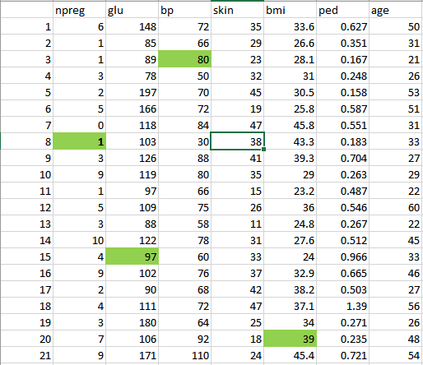
Step 2:
This data has a lot of inconsistencies.
In the column npreg, “one” is written in words, whereas it should be in the numeric form like 1.
In column bp one of the values is 6600 which is impossible (at least for humans) as bp cannot go up to such huge value.
As you can see the Income column is blank and also makes no sense in predicting diabetes. Therefore, it is redundant to have it here and should be removed from the table.
So, we will clean and preprocess this data by removing the outliers, filling up the null values and normalizing the data type. If you remember, this is our second phase which is data preprocessing.
Finally, we get the clean data as shown below which can be used for analysis.

Slide 36
Step 3: Now let’s do some analysis as discussed earlier in Phase 3.
First, we will load the data into the analytical sandbox and apply various statistical functions on it. For example, R has functions like describe which gives us the number of missing values and unique values. We can also use the summary function which will give us statistical information like mean, median, range, min and max values.

Slide 37
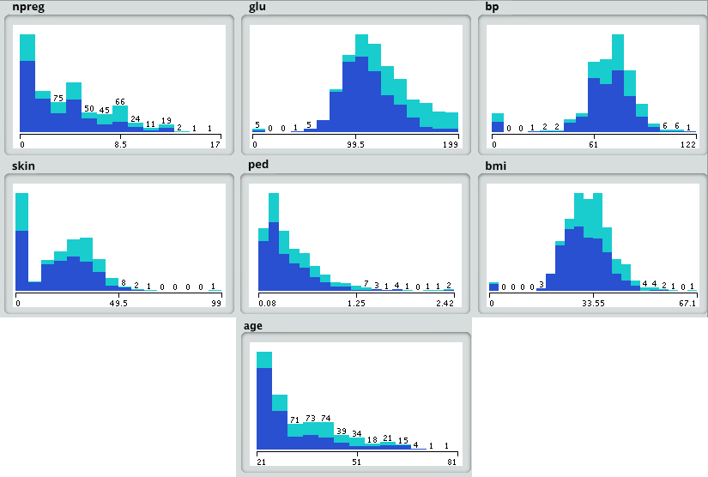
Then, we use visualization techniques like histograms, line graphs, box plots to get a fair idea of the distribution of data.

Slide 38
Step 4:
Now, based on insights derived from the previous step, the best fit for this kind of problem is the decision tree.
Since, we already have the major attributes for analysis like npreg, bmi, etc., so we will unsupervised learning technique to build a model here.
we have particularly used decision tree because it takes all attributes into consideration in one go.
In our case, we have a linear relationship between npreg and age, whereas the nonlinear relationship between npreg and ped.
Decision tree models are also very robust as we can use the different combination of attributes to make various trees and then finally implement the one with the maximum efficiency.

Slide 39
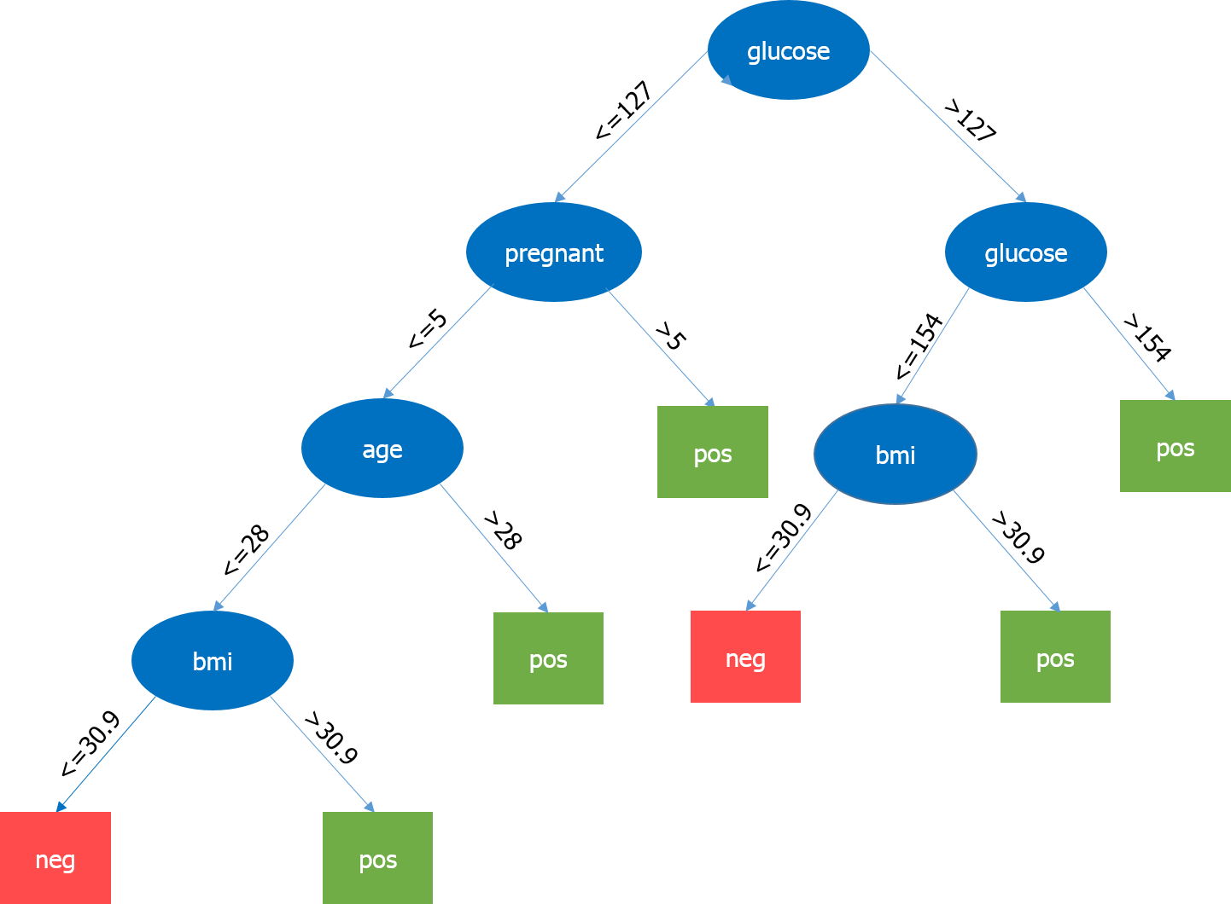

Slide 41
Case Studies/Projects
Product rating Prediction for Amazon (Domain –E-Commerce)
Accurate Sales for 25 stores of Walmart (Domain Retail)
Improving customer Experience for comcast (Domain Telecom)
Predicative Analysis for Healthcare (Domain Health)
MRI Brain Tumor Classification
Lung Cancer Classification

Slide 42
